Slide 1

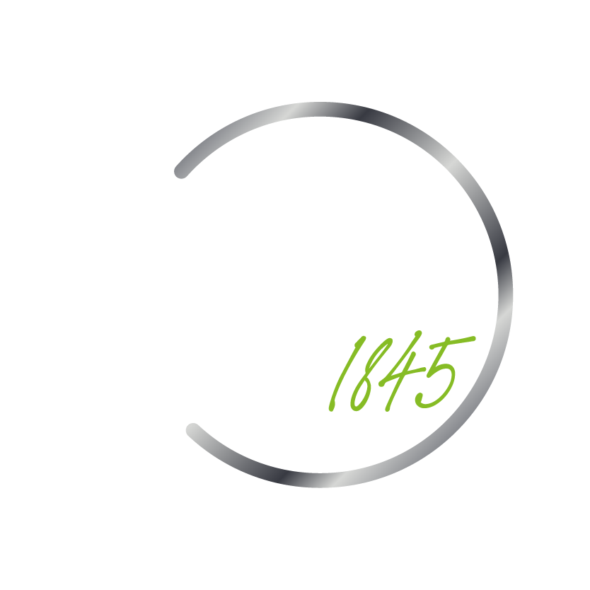
Citizen Data Scientist – Part 1 | Class 5 EDA – Exploratory Data Analysis
Instructor: Kamilla Silva
April 2024

Slide 2

Recalling the last classes...

Slide 3
Main Objective of this Course
Understand and implement techniques for exploring and analyzing datasets without predefined labels or targets;
Gain insights into data distributions, patterns, and relationships through visualization and statistical analysis;
Utilize EDA and unsupervised learning techniques to preprocess and prepare data for further analysis or modeling tasks;
Interpret and communicate the results of EDA and unsupervised learning analyses effectively to support decision-making processes in various domains.

Slide 4

Exploratory Data Analysis

Slide 5
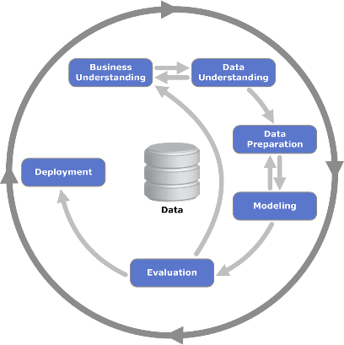
CRISP-DM
Cross-Industry Standard Process for Data Mining
Structured approach for planning and executing data mining projects.

Slide 6
CRISP-DM
Cross-Industry Standard Process for Data Mining
The purpose of Exploratory Data Analysis (EDA) is to summarize the main characteristics of a dataset to better understand its structure, patterns, and relationships.

Slide 7
EDA Steps
Data Collection: Gather the dataset you want to explore.
Data Cleaning: Check for and fix any mistakes or missing values in the data.
Data Exploration: Get a basic understanding of your data through graphs and summary statistics.
Feature Engineering: Create new features or transform existing ones if needed.
Univariate Analysis: Look at individual variables one by one.
Bivariate Analysis: Explore relationships between pairs of variables.
Multivariate Analysis: Examine interactions between multiple variables.
Outlier Detection: Identify and handle any unusual data points that could skew your analysis.
Data Transformation: Prepare the data for modeling by scaling or normalizing it if necessary.
Summary and Insights: Summarize your findings and insights from the EDA process.

Slide 8
Python libraries for data science
NumPy
Data frames; Handling tools
Matplotlib
Charts; Images
Seaborn
Enhanced charts; Exploratory Data Analysis
Scikit-learn
Machine learning
Vectors; Matrices
Pandas
Documentation
Documentation
Documentation
Documentation
Documentation
Scipy
Mathematical calculations and statistics
Documentation

Slide 9
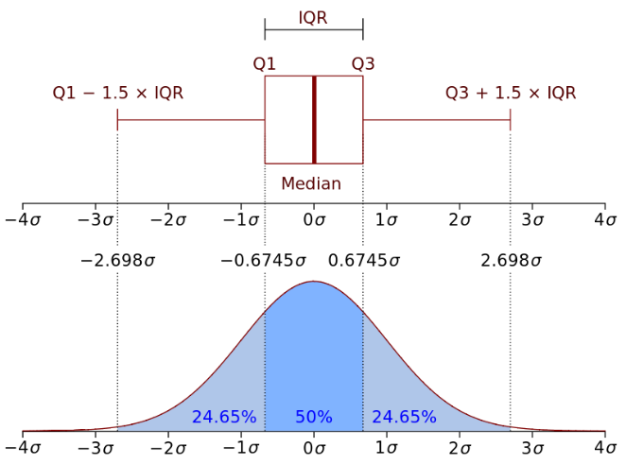
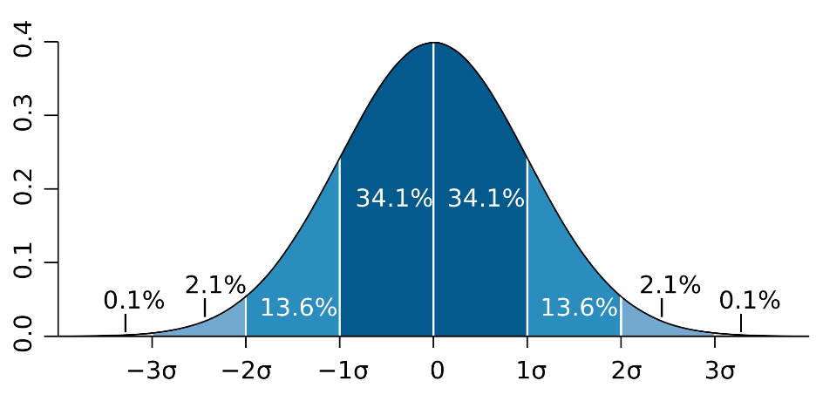
Statistical Analysis
Normal Distribution
Quantiles

Slide 10

EDA - Hands On

Slide 11
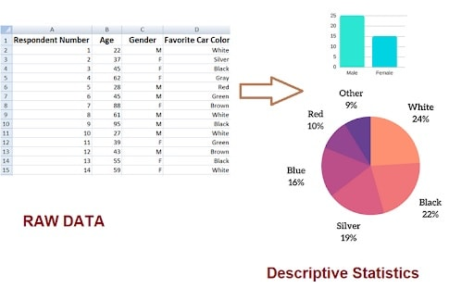
Descriptive Analysis
with Pandas
Main objectives:
Understanding data
Data Summarization
Data Exploration
Quality Assessment

Slide 12
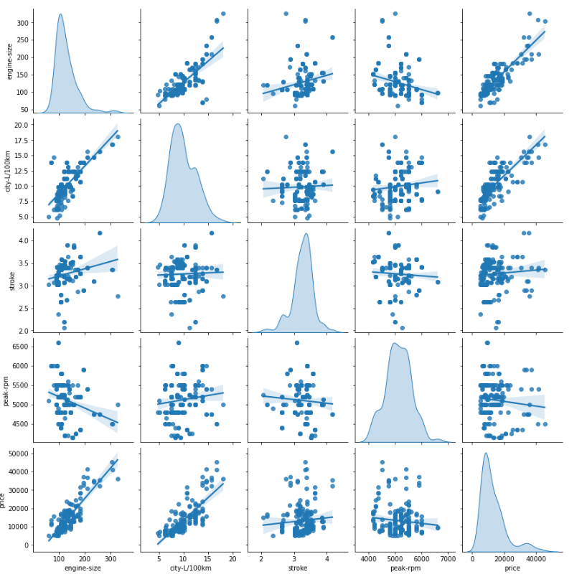
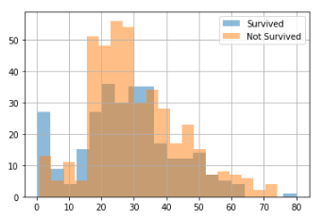
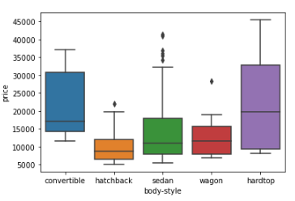
Plot Visualization
with Seaborn
Main objectives:
Understanding data
Indentifying Relationships
Spotting trends and patterns
Comparing groups or categories
Comunicating Insights

Slide 13
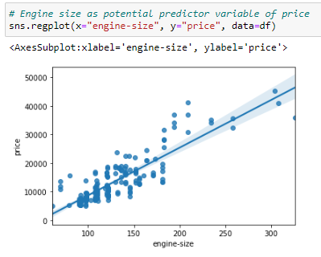
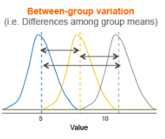
Correlations
with Stats using Pearson’s Correlation and ANOVA
Pearson's Correlation Analysis:
Pearson's correlation analysis is used to measure the strength and direction of the linear relationship between two continuous variables.
Its main objective is to assess the degree of association between variables, indicating how changes in one variable are related to changes in another variable.
Pearson's correlation coefficient (r) ranges from -1 to +1, where values close to +1 indicate a strong positive correlation, values close to -1 indicate a strong negative correlation, and values close to 0 indicate no linear correlation.
ANOVA (Analysis of Variance):
ANOVA is primarily used to analyze the differences among means of three or more groups or treatments.
Its main objective is to determine whether there are statistically significant differences between the means of the groups being compared.
ANOVA helps in understanding the impact of categorical independent variables on a continuous dependent variable and identifying which groups differ significantly from each other.
Why look for Correlations?
Indentify crucial predictors
Parsimony

Slide 14
Missing values
Main objectives:
How to solve?
Identifying Missingness Patterns
Assessing Data Completeness
Understanding Missingness Mechanisms: Different missingness mechanisms, such as missing completely at random (MCAR), missing at random (MAR), or missing not at random (MNAR), require different handling approaches.
Evaluating Impact on Analysis
Implementing Handling Strategies
Complete Case Analysis
or
Mean/Median Imputation
or
KNN Imputation
and
Interative Imputation
Today’s class
Why look for Missing Values?
Identify important information that was lost
Prepare Variable for model

Slide 15
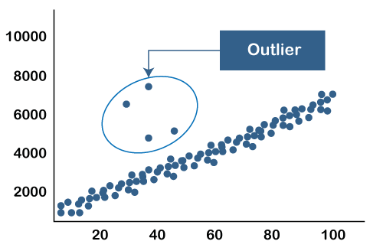
Outliers
"An outlier is an observation which deviates so much from the other observations as to arouse suspicions that it was generated by a different mechanism." [D. Hawkins. Identification of Outliers, Chapman and Hall , 1980.]
Methods that help to identify Outliers:
If the variable is Normally distributed (Gaussian):
Outliers = mean +/- 3* std
If the variable is skewed distributed, a general approach is to calculate the quantiles, and then the inter-quantile range (IQR), as follows:
IQR = 75th quantile - 25th quantile
An outlier will sit outside the following upper and lower boundaries:
Upper boundary = 75th quantile + (IQR * 1.5)
Lower boundary = 25th quantile - (IQR * 1.5)
or for extreme cases:
Upper boundary = 75th quantile + (IQR * 3)
Lower boundary = 25th quantile - (IQR * 3)
How to solve?
Trimming
or
Censoring
or
Discretization
Why look for Outiliers?
Identify suspicious information
Prepare Variable for model
Today’s class

Slide 16
Recommended Reading
Machine Learning University:
https://mlu-explain.github.io/

Slide 17
Today’s Class…..

Slide 18
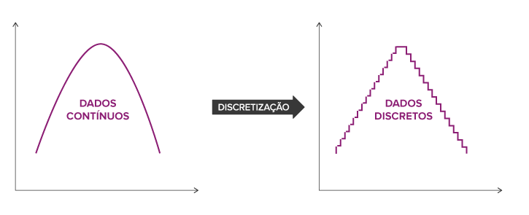
Discretization
The process of transforming continuous functions, models, variables and equations into discrete counterparts.
This is important, as some algorithms only work with inputs of discrete values, not predicting continuous values.
Discretization creates a limited number of possible states.
Discretization
Continuous Variable
Discrete Variable

Slide 19
Discretization
Example: Car Insurance Price
Age is a good predictor for the risk of na accident
There is no significant difference in risk for individuals aged 18 or 19
Creating age groups helps in separating the risk
Probability of an accident occurring by groups:
Group 1: Individuals aged 18-25 years
Group 2: Individuals aged 26-30 years
Group 3: Individuals aged 30-45 years
Group 4: Individuals aged 45-60 years
Group 5: Individuals aged over 60 years

